Slide 1
Oracle ERP in recruitment

Slide 2
Introduction
In this case we have our company Fly High airlines that is having difficulties managing the number of applicants and recording their data.
With using Oracle ERP system, we aim to facilitate the managing of data of the applicants and integrate them when they are part of the company
What motivated us to do this is because people are the most important part of any organization, and we want to facilitate the on boarding process as much as possible for the Human resources department.

Slide 3
Target users
Global corporates
Enterprise
Small to medium businesses
Freelancers

Slide 4

Project scope
Gathering the necessary information needed to establish an airline company, Setup the organizational hierarchy, departments, and workflows within Oracle ERP E-Business Suite, testing every step of the module to ensure each action is implemented without errors.

Slide 5
Development process
1-Creating users and their responsibilities
2- Requisition and vacancy.
3- Recruitment activity.
4- Applicant quick entry.
5- Mass update of applicants

Slide 6
Implementation
1-Creating users and their responsibilities
After the installation of the program the new users will have their responsibilities assigned to them with user names and passwords that they can change upon logging in for the first time.

Slide 7
Implementation
2-Requisition and vacancy.
During this stage, we focused on identifying and creating critical roles essential for the Finance 2024 and Production 2024 tracks. The key positions established
1. Finance Manager
2. Accounting Section Head
3. Supply Chain Manager

Slide 8
Implementation
3-Recruitment activity
Recruitment activity for several available vacancies at the company
created 2 recruitment activities from the recruitment function for 3 available vacancies
First recruitment activity is a LinkedIn ad
Second recruitment activity is a recruitment agency

Slide 9
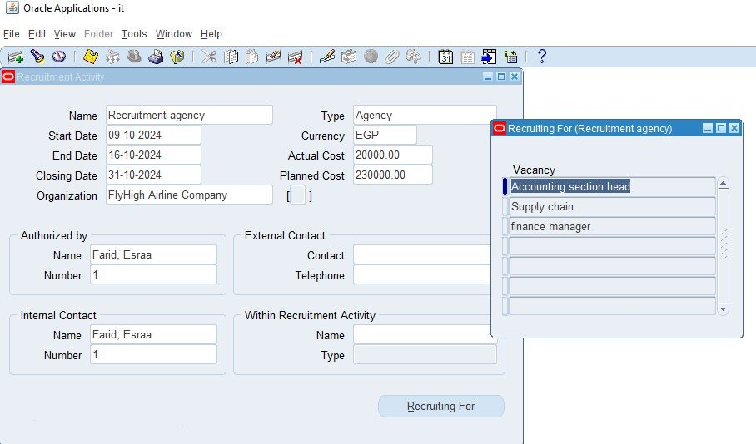
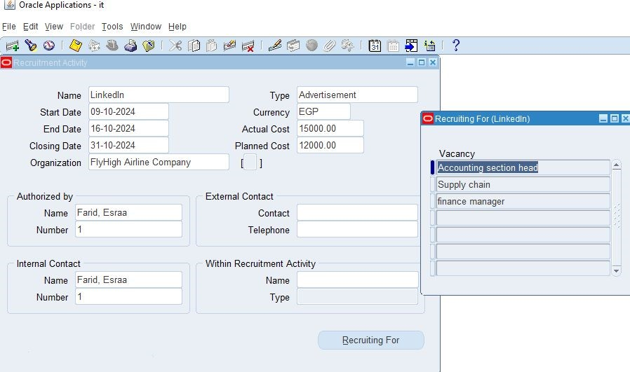

Slide 10
Implementation
4- Applicant quick entry
Enter The Applicants Required Information like the phone and name and the current employer. The address and the position applied for.

Slide 11
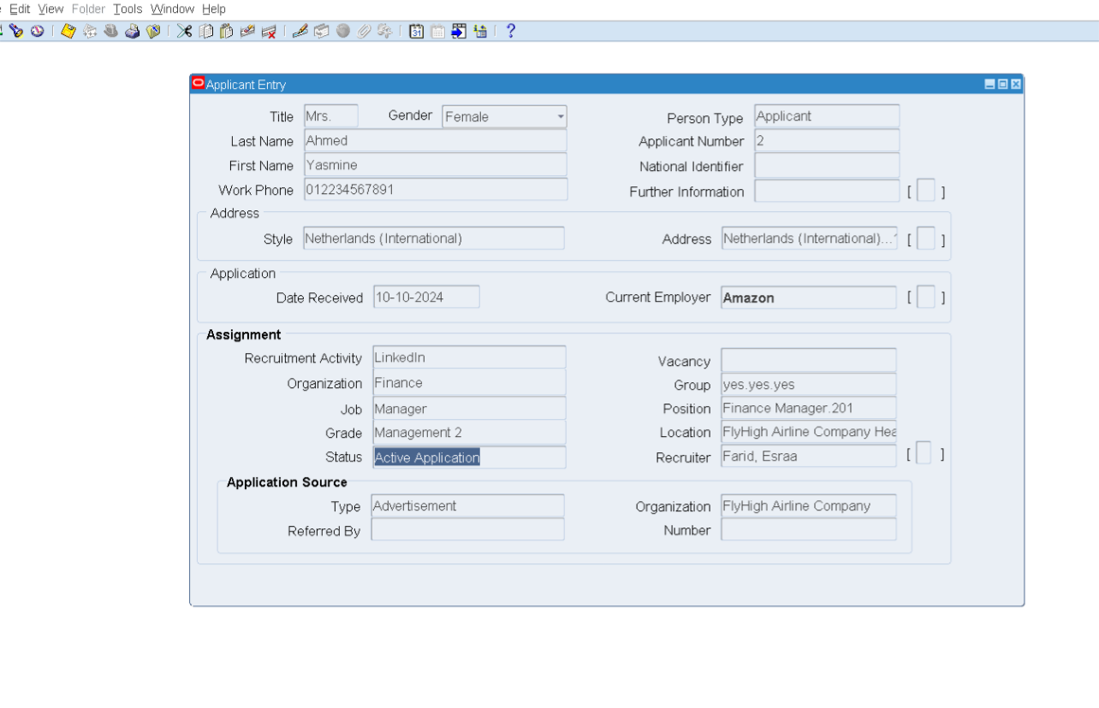

Slide 12
Implementation
4- Mass update of the applicants
Query the screen
And view the applicant’s statuses.
Select One or Select All Applicants
Press The “Update” Button to Update their Statuses & Enter the Recruiter Name

Slide 13
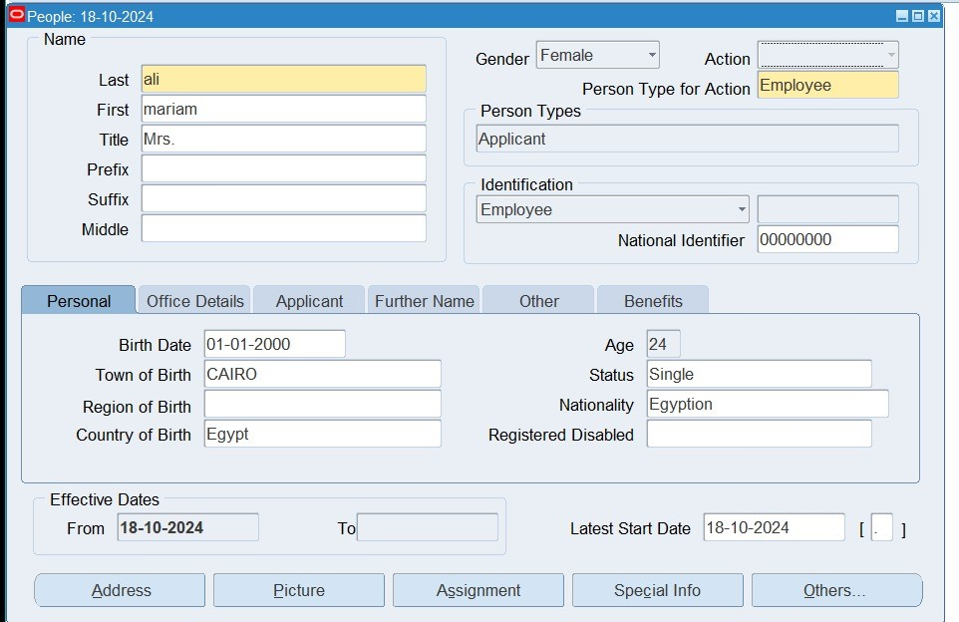
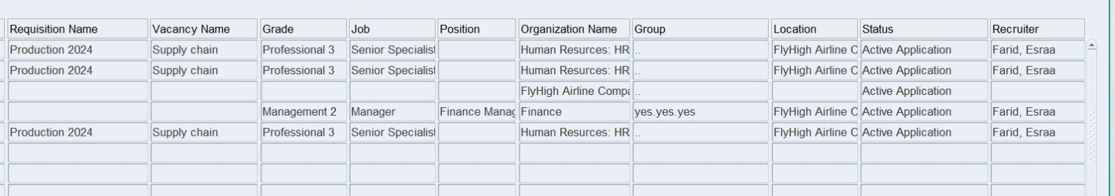
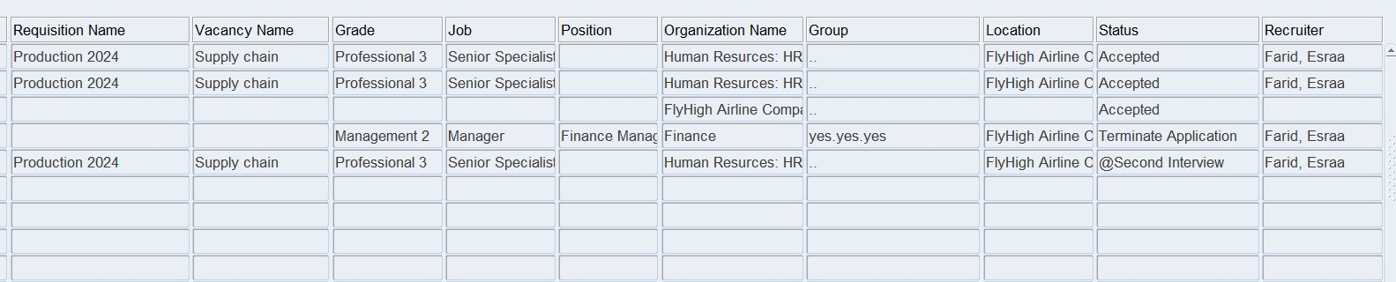

Slide 14
Project outcome
Digitalizing the process would make much easier and not as time consuming as it usually is. Oracle ERP system is one of many that facilitates the recruitment and allows organizations to store hundreds of millions of data for applicants and employees at the tip of the recruiter’s fingers.

Slide 15

conclusion
People will always be the backbone of any organization and will either lead to its downfall or its success. That's why the recruitment process is considered one of the most important steps in building any organization.
Now after we have showed how the process works; we hope many organizations will be able to make use of the program to build leading organizations.

Slide 16
Acknowledgments
Thank you to everyone who contributed and taught us to use this great tool.
Thank you team members for your contributions and the supervisors
Team members:
Dina Elsayed Elsayed
Yasmine Ahmed Saeed
Amira Mostafa Abd-Elrazik
Felopater Maged Fawz
Esraa Farid Shawky

Slide 17
Any questions?

Slide 18
Thank you for your time

